Slide 1
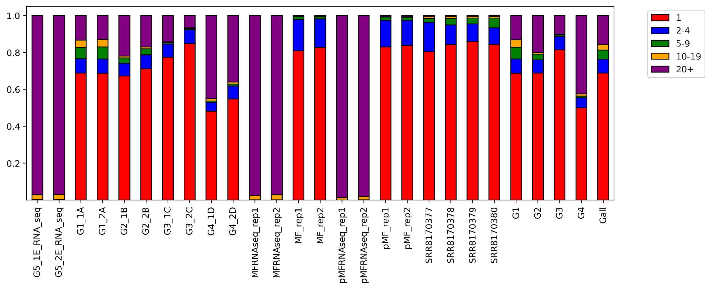
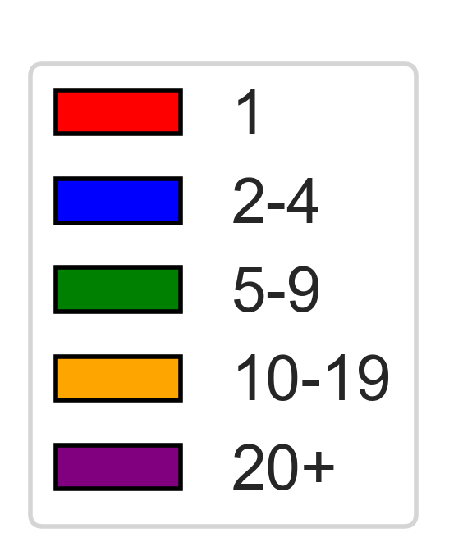
1.0
0.8
0.6
0.4
0.2
0
p-m⁵Cs per read
Proportion of reads
Mitochondrial RNA
Huang
RNAseq
MT-A
MT-B
MT-C
MT-D
Supplementary Figure 7. Binned C counts of each library. Number of p-m⁵C occurrences in every read was quantified, then binned accordingly. Reads with 0 p-m⁵Cs are not shown.

